Slide 1
Memorising Game

Slide 2
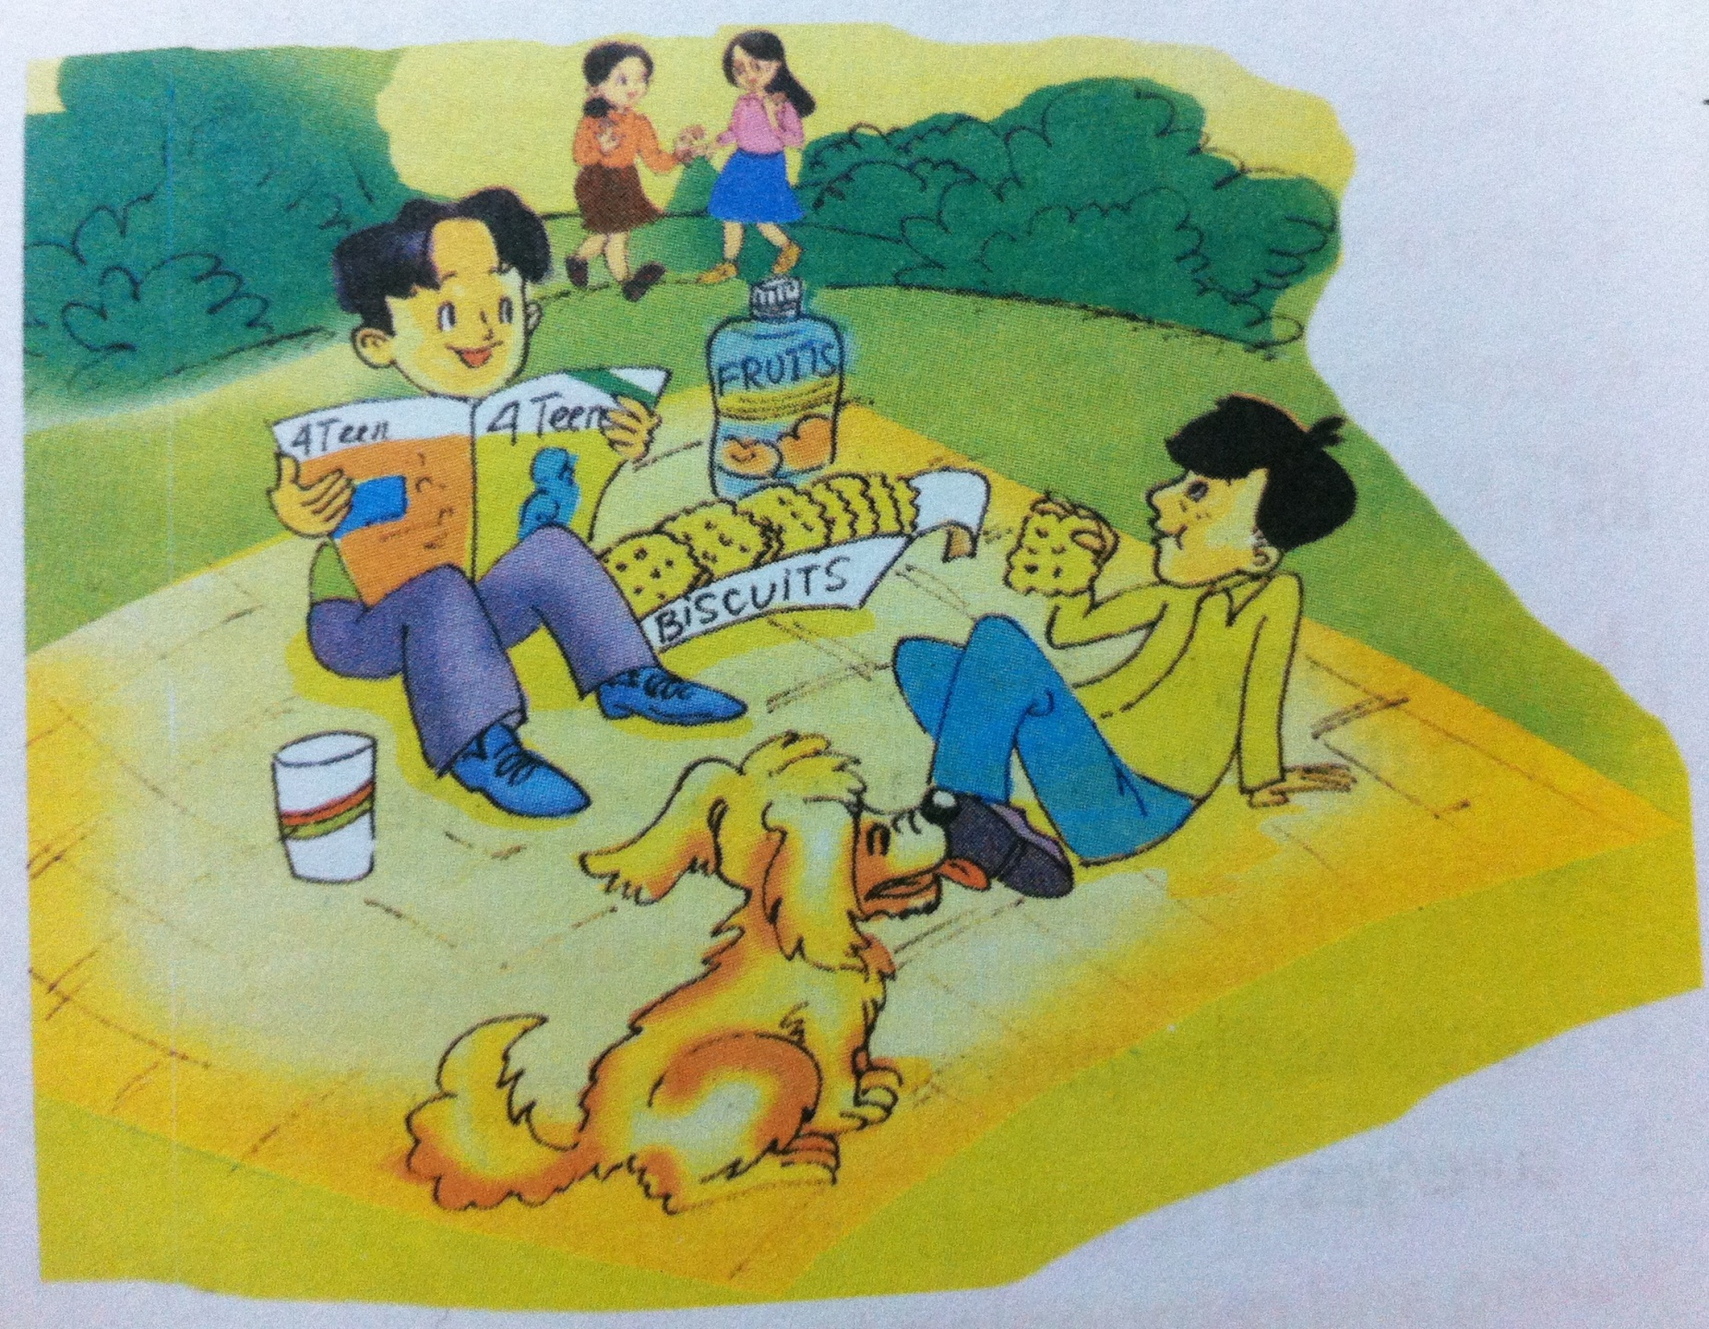

Slide 3
Unit 3- MY FRIENDS
Period 16:
Lesson 1- Getting started

Slide 4
NEW WOrds
- confident (adj) :
tự tin
- shy (adj) :
nhút nhát
- boring (adj) :
buồn tẻ/ tẻ nhạt
- talkative (adj) :
hay nói

Slide 6

1. Put a suitable word in each blank.
1. Guess a suitable word in each blank.
Phuc and Duong are having a __________.
Lucas _____________ picnic.
Lucas is a ________________dog.
Phong and Duong see ___________and ___________.
Chau has __________ , and she has ______________.
This evening, Mai and Chau are ________________.
picnic
likes/ loves
friendly
Mai
Chau
glasses
long black hair
working on their school project

Slide 7
Making a request ( ask for help)
- Can you + V(inf)……..?
Agree: Yes, sure
Disagree: I’m sorry.
Making a suggestion
- Would you like + V(inf)……..?
Agree: Yes, I’d love to.
Disagree: Oh, sorry, I can’t.

Slide 8
2. Put the words in the correct order:
Making and responding to a request.
1. can/ pass/ the / please/ biscuits / you / me?
Can you pass me the biscuits please?
2. sure/ yes
Yes, sure.
Making and responding to a suggestion.
1. sit down / like to / would / you?
Would you like to sit down?
2. sorry / oh / can’t / we.
Oh, sorry. We can’t.

Slide 9
Lucky number
Pass the pen
5
1
listen to music
6
play outside
turn on the lights
2
move the chair
have a picnic
3
7
4
LUCKY NUNBER
LUCKY NUNBER
8
Ask for help : Can you ______________ please?
Yes, sure
Make a suggestion: Would you like to __________?
Yes, I’d love to. / Sorry, I can’t.

Slide 10
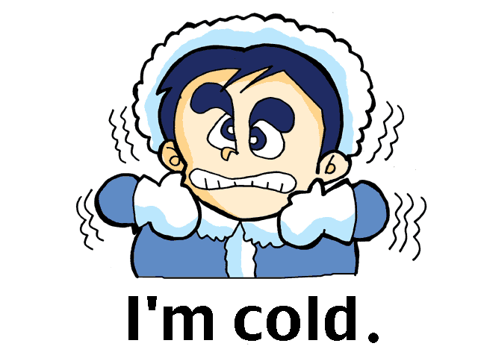
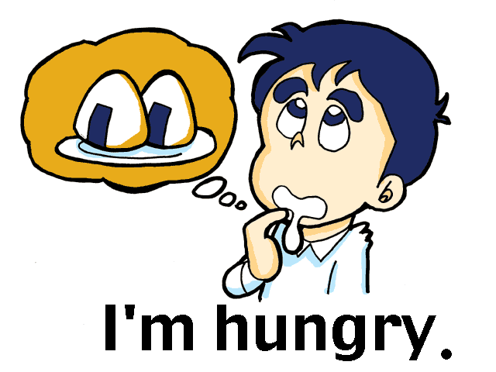
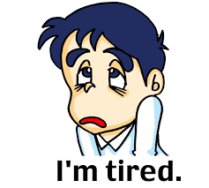
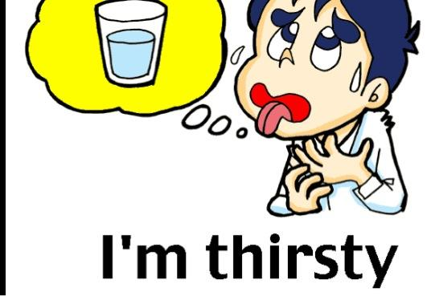
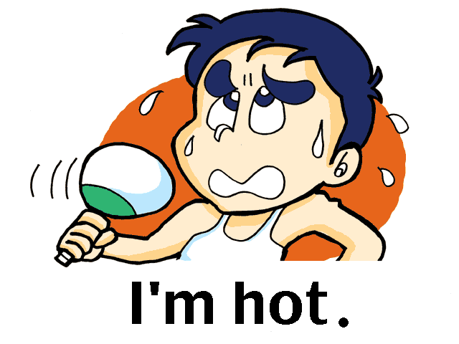
Make a REQUEST or a SUGGESTION
for these situations

Slide 11
3. Choose the adjectives in the box to complete the sentences.
talkative clever boring creative shy
kind confident hard-working friendly funny
Mina is very _____________. She likes to . She always has lots of .
Thu is _____________. He likes to his friends.
Minh Duc is ________________. He isn’t shy. He likes to .
Kim is very ___________. She’s, , to friends.
Mai is ________. She things
creative
draw pictures
new ideas
friendly
help
confident
meeting new people
talkative
always on the phone
chatting
clever
understands
quickly and easily

Slide 12
To express PERSONALITY, we use:
(+) S+ is / are / am + Adjective
(- ) S+ is / are / am + NOT + Adjective

Slide 13

Friendship Flower
Minh
kind
funny

Slide 14

HOMEWORK
Make 5 sentences with request.
Make 5 sentences with suggestion
Make 5 sentences using “ be+ adjective” ( for personality)

